Slide 1
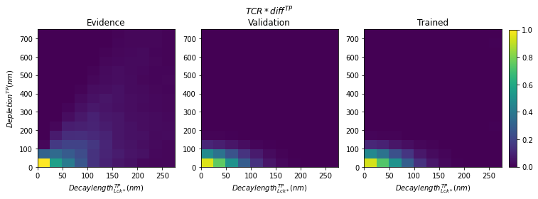
Fig. S7 - Model 3 – TCR phosphorylation (TP) – Evidence, validation, trained
A
B
C

